Slide 1
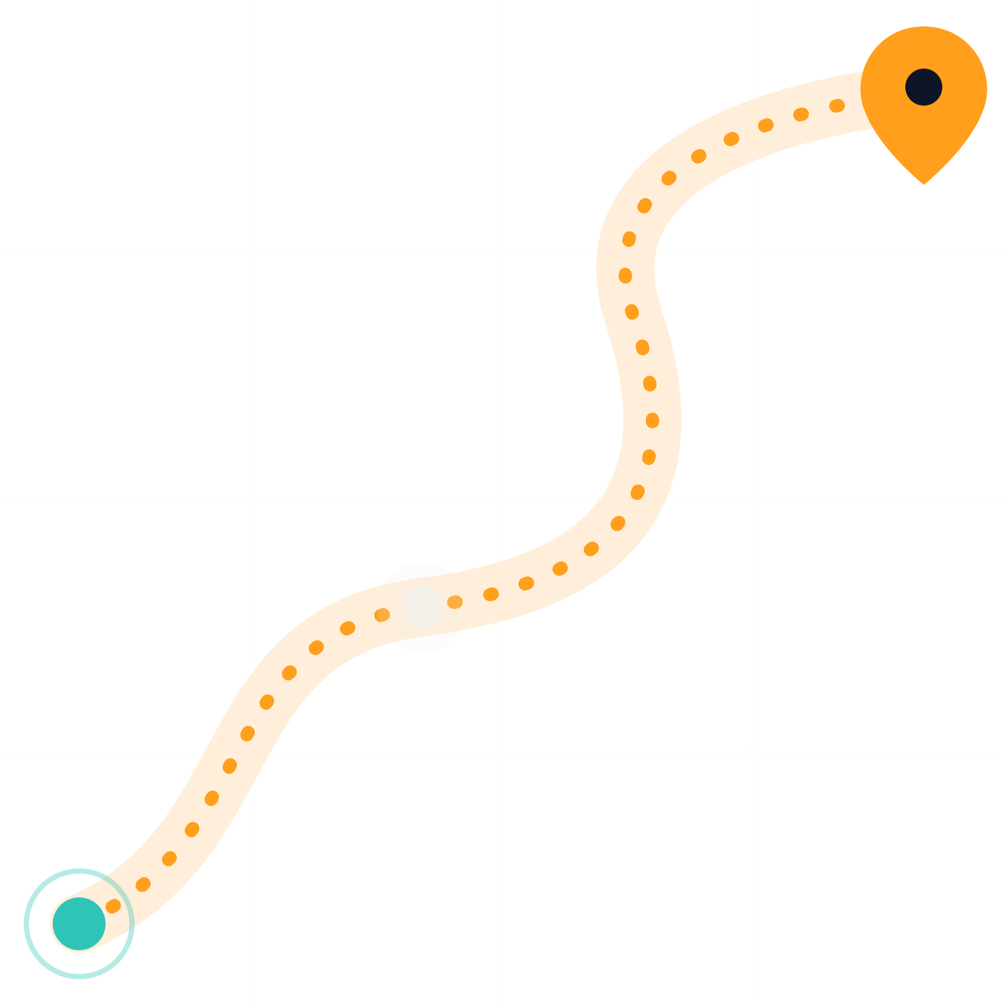
Live Delivery Tracker
PDC · CLOUD SERVICES PRESENTATION
Amazon Location Service + AWS IoT Core
FAST-NUCES Islamabad · [Presenter 1] · [Presenter 2]
Notes:
[Presenter 1] · about 15 seconds Assalam-o-Alaikum and good morning everyone. We are [Presenter 1] and [Presenter 2]. Today we will show you how to track a delivery truck live on a map, using two AWS services: AWS IoT Core and Amazon Location Service.

Slide 2



“Where is my delivery right now?”
THE PROBLEM · [PRESENTER 1]
Every vehicle reports
Every position is kept
Every answer is live
A GPS position every few seconds, over shaky mobile networks.
Customers and dispatchers see the truck move as it happens.
A history you can query, replay and draw on a map.
Notes:
[Presenter 1] · about 30 seconds Think about the last time you ordered food or booked a ride. The first thing you check is: where is it right now? Behind that little moving icon is a hard problem. Every vehicle has to report its position every few seconds over unreliable mobile networks. Every position has to be stored. And the answer has to be live, for thousands of vehicles at the same time. Building that yourself means servers, databases and a lot of scaling work. We wanted to see how far managed cloud services can take us.

Slide 3






How the data flows
OUR SOLUTION · [PRESENTER 1]
Truck
IoT Core
IoT rule
Tracker
Live map
Python program sends its GPS once a second
Receives MQTT messages over TLS
Forwards every message, no servers
Stores the truck’s position history
Draws the route as it grows
truck01
trucks/location
SELECT *
DeliveryTracker
localhost:8000
▬ AWS IoT Core
▬ Amazon Location Service
Notes:
[Presenter 1] · about 35 seconds Here is what we built. Our truck is a Python program pretending to be a GPS device. Once a second it sends its location to AWS IoT Core. An IoT rule picks up every message and forwards it to an Amazon Location tracker, which stores the truck’s position history. Finally, our live map reads that history and draws the route. Notice that no part talks directly to another: each piece only hands data to the cloud. The orange parts are AWS IoT Core, which I will explain. The teal parts are Amazon Location Service, which [Presenter 2] will explain.

Slide 4




Connecting devices, securely
AWS IOT CORE · [PRESENTER 1]
Things & certificates
MQTT publish/subscribe
truck01 is registered with its own X.509 certificate. No passwords.
Lightweight messaging for weak networks. Devices publish to topics.
Policies
Rules engine
truck01 may only connect as itself and publish to one topic.
SQL-like rules send messages on to other AWS services.
Notes:
[Presenter 1] · about 45 seconds AWS IoT Core is a managed service that connects devices to the cloud. Four ideas matter here. First, every device is registered as a “thing”. Ours is truck01, and it has its own X.509 certificate, so it proves who it is without a password. Second, devices talk using MQTT, a lightweight publish/subscribe protocol designed for weak mobile networks. A device publishes to a topic; anyone interested subscribes to it. Third, a policy says exactly what the device may do. Our truck can only connect as truck01 and publish to one topic, nothing else. And fourth, the rules engine: SQL-like rules that react to messages and send them to other AWS services, without us running any servers.

Slide 5
One message, one rule
INSIDE IOT CORE · [PRESENTER 1]
The truck publishes to trucks/location
The IoT rule truck_location_rule
{
SELECT * FROM
'trucks/location'
"deviceId": "truck01",
"latitude": 33.6563,
"longitude": 73.0153,
Action: Amazon Location tracker
"timestamp": "…T16:20:01Z"
${deviceId} ${latitude} ${longitude}
→ DeliveryTracker
}
On error: republish to errors/trucks
Notes:
[Presenter 1] · about 30 seconds This is the actual message our truck publishes on the topic trucks/location: a device ID, latitude, longitude and a timestamp, in plain JSON. Our rule is one line of SQL: select everything from that topic. Its action is Amazon Location: it takes deviceId, latitude and longitude out of each message and writes them into our tracker, DeliveryTracker. If the rule ever fails, the error is republished to a separate topic, errors/trucks, so we can debug it. Now [Presenter 2] will show you where the data goes.

Slide 6




Turning positions into places
AMAZON LOCATION SERVICE · [PRESENTER 2]
Trackers
Routes
Store position history. Moves under 30 m are filtered out.
Real road routes. Our truck follows one to Faisal Mosque.
Maps
Geofences (next step)
Map tiles through an API key that can only load tiles.
Alert when the truck enters or leaves an area.
Notes:
[Presenter 2] · about 45 seconds Amazon Location Service adds maps and location features to applications. We used three of its parts. Trackers store each device’s position history. We chose distance-based filtering, which ignores moves smaller than 30 metres, so GPS jitter does not waste storage or money. Routes calculates real road routes. Our truck follows the road route it gave us from FAST to Faisal Mosque. And Maps gives us the map itself, through an API key that is only allowed to load map tiles, and only from our dashboard. A fourth feature, geofences, could alert us when the truck enters or leaves an area, like the customer’s street. That is our next step.

Slide 7




A small distributed system
WHY THIS IS PDC · [PRESENTER 2]
Decoupled
Event-driven
Publish/subscribe: the truck never knows the tracker exists.
Each message triggers work. No server sits idle waiting.
Parallel at scale
Reliable
One truck or thousands publish in parallel. AWS scales out.
QoS 1: at-least-once delivery, encrypted with TLS.
Notes:
[Presenter 2] · about 35 seconds Why does this belong in a Parallel and Distributed Computing course? Because it is a small distributed system. It is decoupled: with publish/subscribe, the truck never knows the tracker exists. We could add a second consumer, like an SMS alert, without touching the truck. It is event-driven: every message triggers work, and nothing sits idle in between. It runs in parallel at scale: the same setup works for one truck or thousands, each publishing at the same time, and AWS scales out for us. And it is reliable: messages use MQTT quality of service 1, meaning at-least-once delivery, over an encrypted TLS connection.

Slide 8
Let’s watch it move
LIVE DEMO · [PRESENTER 1] + [PRESENTER 2]
1
2
3
Start the live map
Start truck01 over MQTT
Watch the messages and the map
py -3.13 dashboard.py
truck_simulator.py --mode mqtt
MQTT test client · localhost:8000
Backup if the Wi-Fi fails: our recorded demo video
Notes:
[Presenter 1] + [Presenter 2] · about 90 seconds (switch to the laptop) [Presenter 2] Let’s see it live. I start our dashboard. This is the map of Islamabad, still empty. [Presenter 1] And I start truck01. It connects to IoT Core with its certificate — you can see “connected” here. [Presenter 1, switch to the AWS console] In the MQTT test client you can see every message arriving, one per second, with the truck’s latitude and longitude. [Presenter 2, switch to the map] And here is the truck leaving FAST. The trail is not drawn from our laptop’s memory: the map reads it back from the Amazon Location tracker every two seconds. [Presenter 2] The whole trip is about 11 kilometres and takes under three minutes, so we will let it drive while we continue, and come back to it at the end. (If anything fails, play the backup video and keep talking over it.)

Slide 9
What surprised us
LESSONS LEARNED · [PRESENTER 1]
What happened | What we learned
Our new IoT address “did not exist” for minutes | New DNS names take time, and networks cache “not found” answers too
The truck jumped instead of moving | Time-based filtering keeps one position per 30 s, so we switched to distance-based
“Access denied”, again and again | Least privilege: every piece gets exactly the permissions it needs, nothing more
Notes:
[Presenter 1] · about 30 seconds Three things surprised us while building this. First, our new IoT endpoint address “did not exist” for several minutes. New DNS names take time to spread, and networks even cache the “not found” answer. Second, our truck jumped across the map instead of moving smoothly. The tracker’s default time-based filtering keeps only one position every 30 seconds, so we switched to distance-based filtering. And third, permissions. Every piece needed exactly the right policy, which taught us the principle of least privilege the hard way.

Slide 10
Same pattern, many products
REAL WORLD & COST · [PRESENTER 2]
Ride-hailing apps
$0
Food and parcel delivery
out of pocket: covered by AWS Free Tier credits
Fleet and asset tracking
IoT Core bills per million messages; a demo trip sends about 150. A zero-spend budget emails us if anything ever costs money.
School-bus tracking
Notes:
[Presenter 2] · about 25 seconds The same pattern powers products you use every day: ride-hailing apps, food and parcel delivery, fleet and asset tracking, and school-bus tracking. And the cost for us was zero out of pocket. IoT Core is billed per million messages, and one demo trip sends about 150. Everything was covered by AWS Free Tier credits, and we set a zero-spend budget, so AWS emails us if anything ever starts costing money.

Slide 11

Thank you
DELIVERED · FAISAL MOSQUE
AWS IoT Core gets device data into the cloud, securely.
Amazon Location Service turns it into places on a map.
Questions?
[Presenter 1] · [Presenter 2] · FAST-NUCES Islamabad
Notes:
[Presenter 2] · about 15 seconds (switch back to the map first) And our truck has just arrived at Faisal Mosque. To sum up: AWS IoT Core gets device data into the cloud securely, and Amazon Location Service turns it into places on a map. Together, with no servers of our own, they make a live tracking system. Thank you. We are happy to take your questions.

